Slide 1
📊 Let’s Test Your Knowledge!
Answer the following 20 questions to check what you’ve learned about digital tools, cybersecurity, and smart habits!

Slide 2
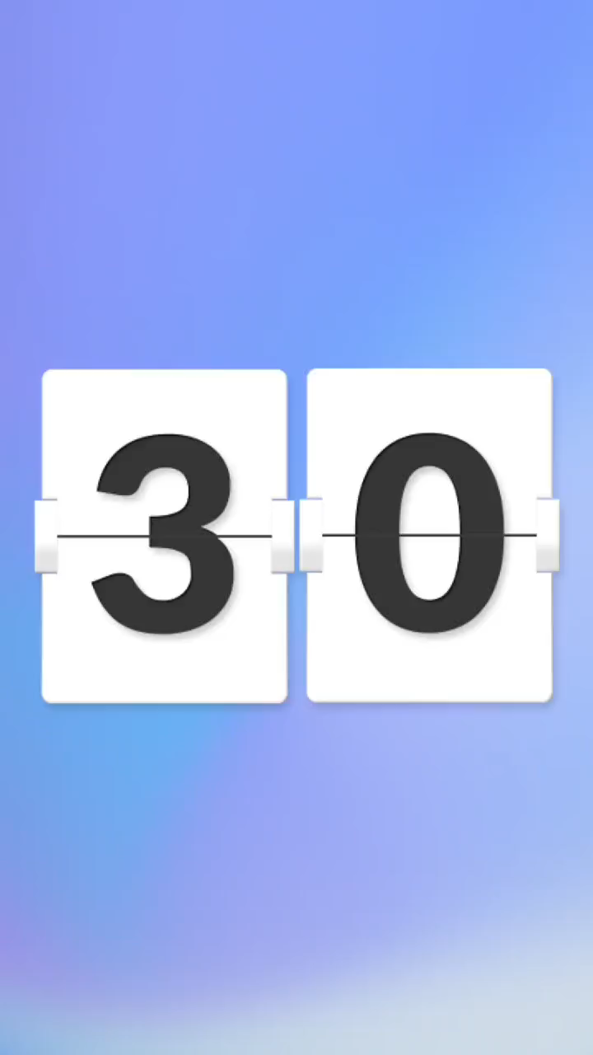


Question 1
What is digital literacy?
A. Knowing how to code
B. Ability to use digital devices and tools effectively
C. Playing video games
D. Reading printed books

Slide 3
Question 2
Which tool helps you organize notes efficiently?
A. Calculator
B. Camera
C. Maps
D. Notion

Slide 4
Question 3
What is an example of an educational resource online?
A. YouTube learning channels
B. Social media reels
C. Online shopping websites
D. Gaming platforms

Slide 5
Question 4
What is phishing?
A. A new video trend
B. A scam trying to steal your personal info
C. A game played online
D. A fitness app

Slide 6
Question 5
Which is a sign of a phishing email?
A. It’s from a verified company
B. It only offers free content
C. It never contains links
D. It asks for passwords or bank details

Slide 7
Question 6
Two-factor authentication helps you by…
A. Speeding up your internet
B. Adding extra security when logging in
C. Increasing storage space
D. Automatically sharing files

Slide 8
Question 7
Which app helps improve your writing?
A. Grammarly
B. Maps
C. YouTube
D. Netflix

Slide 9
Question 8
AI tools like ChatGPT are useful because…
A. They replace all teachers
B. They assist with writing, learning, and problem-solving
C. They slow down your device
D. They only work in labs

Slide 10
Question 9
Notion is used for…
A. Streaming movies
B. Playing music
C. Organizing tasks, notes, and schedules
D. Editing videos

Slide 11
Question 10
Forest app helps you…
A. Shop online
B. Focus on tasks by planting virtual trees
C. Connect with friends
D. Watch videos without ads

Slide 12
Question 11
Why should you avoid using the same
password everywhere?
A. It saves time
B. It makes your device faster
C. It’s easier to remember
D. It increases security risks

Slide 13
Question 12
What’s a benefit of using Google Calendar?
A. It helps you track video views
B. It reminds you of important tasks and deadlines
C. It connects you to random people
D. It deletes old files automatically

Slide 14
Question 13
Which of the following is a healthy tech habit?
A. Using apps for focus and time management
B. Watching videos all night
C. Ignoring assignments
D. Not updating apps

Slide 15
Question 14
What’s the main purpose of using productivity apps?
A. Distract yourself
B. Watch more content
C. Improve organization and efficiency
D. Avoid learning

Slide 16
Question 15
Which app helps you manage tasks using boards and lists?
A. Instagram
B. Trello
C. YouTube
D. WhatsApp

Slide 17
Question 16
How does technology affect mental health if overused?
A. Improves focus always
B. Can cause stress and anxiety
C. Has no effect
D. Makes you smarter overnight

Slide 18
Question 17
Which app helps you take notes and organize them across devices?
A. Evernote
B. Maps
C. Calculator
D. Music player

Slide 19
Question 18
What should you do if you receive a suspicious email?
A. Click the link immediately
B. Delete or report it
C. Share with friends
D. Ignore and save it

Slide 20
Question 19
What helps you balance screen time while studying?
A. Forest or focus timer apps
B. Social media apps
C. Games with rewards
D. Streaming platforms

Slide 21
Question 20
What is the best way to stay safe online?
A. Use strong passwords and secure networks
B. Share passwords with friends
C. Click on unknown links
D. Use outdated software

